Slide 1
Software Design and Analysis
Logical Models: Structural Models
Class Diagram
Department of Software Engineering,
FAST-NUCES, CFD Campus

Slide 2
Lecture Material
System Analysis and Design in a Changing World (Chapter 12)

Slide 3
Lecture Outline
Class diagram fundamentals
CD design guidelines
CD constructs
Example

Slide 4
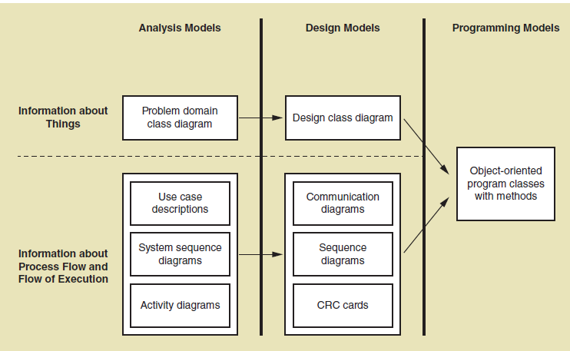
Class Diagram Fundamentals

Slide 5
Class Diagram Fundamentals – Domain Models
It helps to get the rough idea of the system structure and potential conceptual classes.
illustrates meaningful conceptual classes in a problem domain.
is NOT a set of diagrams describing software classes, or software objects and their responsibilities.
It may show:
  concepts
  associations between concepts
  attributes of concepts
A CD is an extended form of domain models and illustrates the specifications for software classes and interfaces

Slide 6
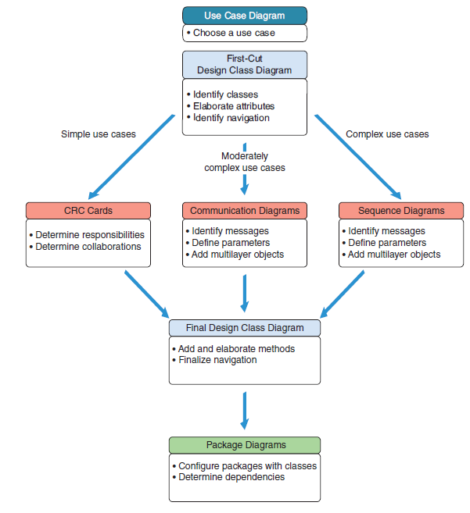
CD Design Guidelines

Slide 7
CD Fundamentals – CRC
CRC modeling provides a simple means for identifying and organizing the classes that are relevant to system or product requirements.
Responsibilities are the attributes and operations that are relevant for the class
Collaborators are those classes that are required to provide a class with the information needed to complete a responsibility.

Slide 8
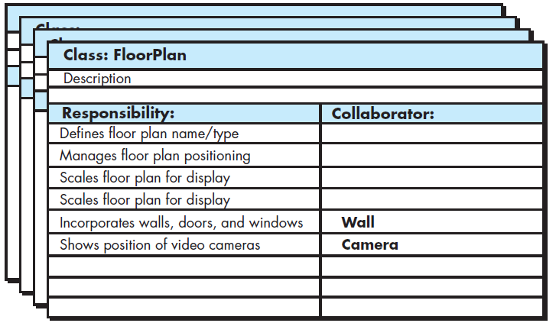
CD Fundamentals – CRC

Slide 9
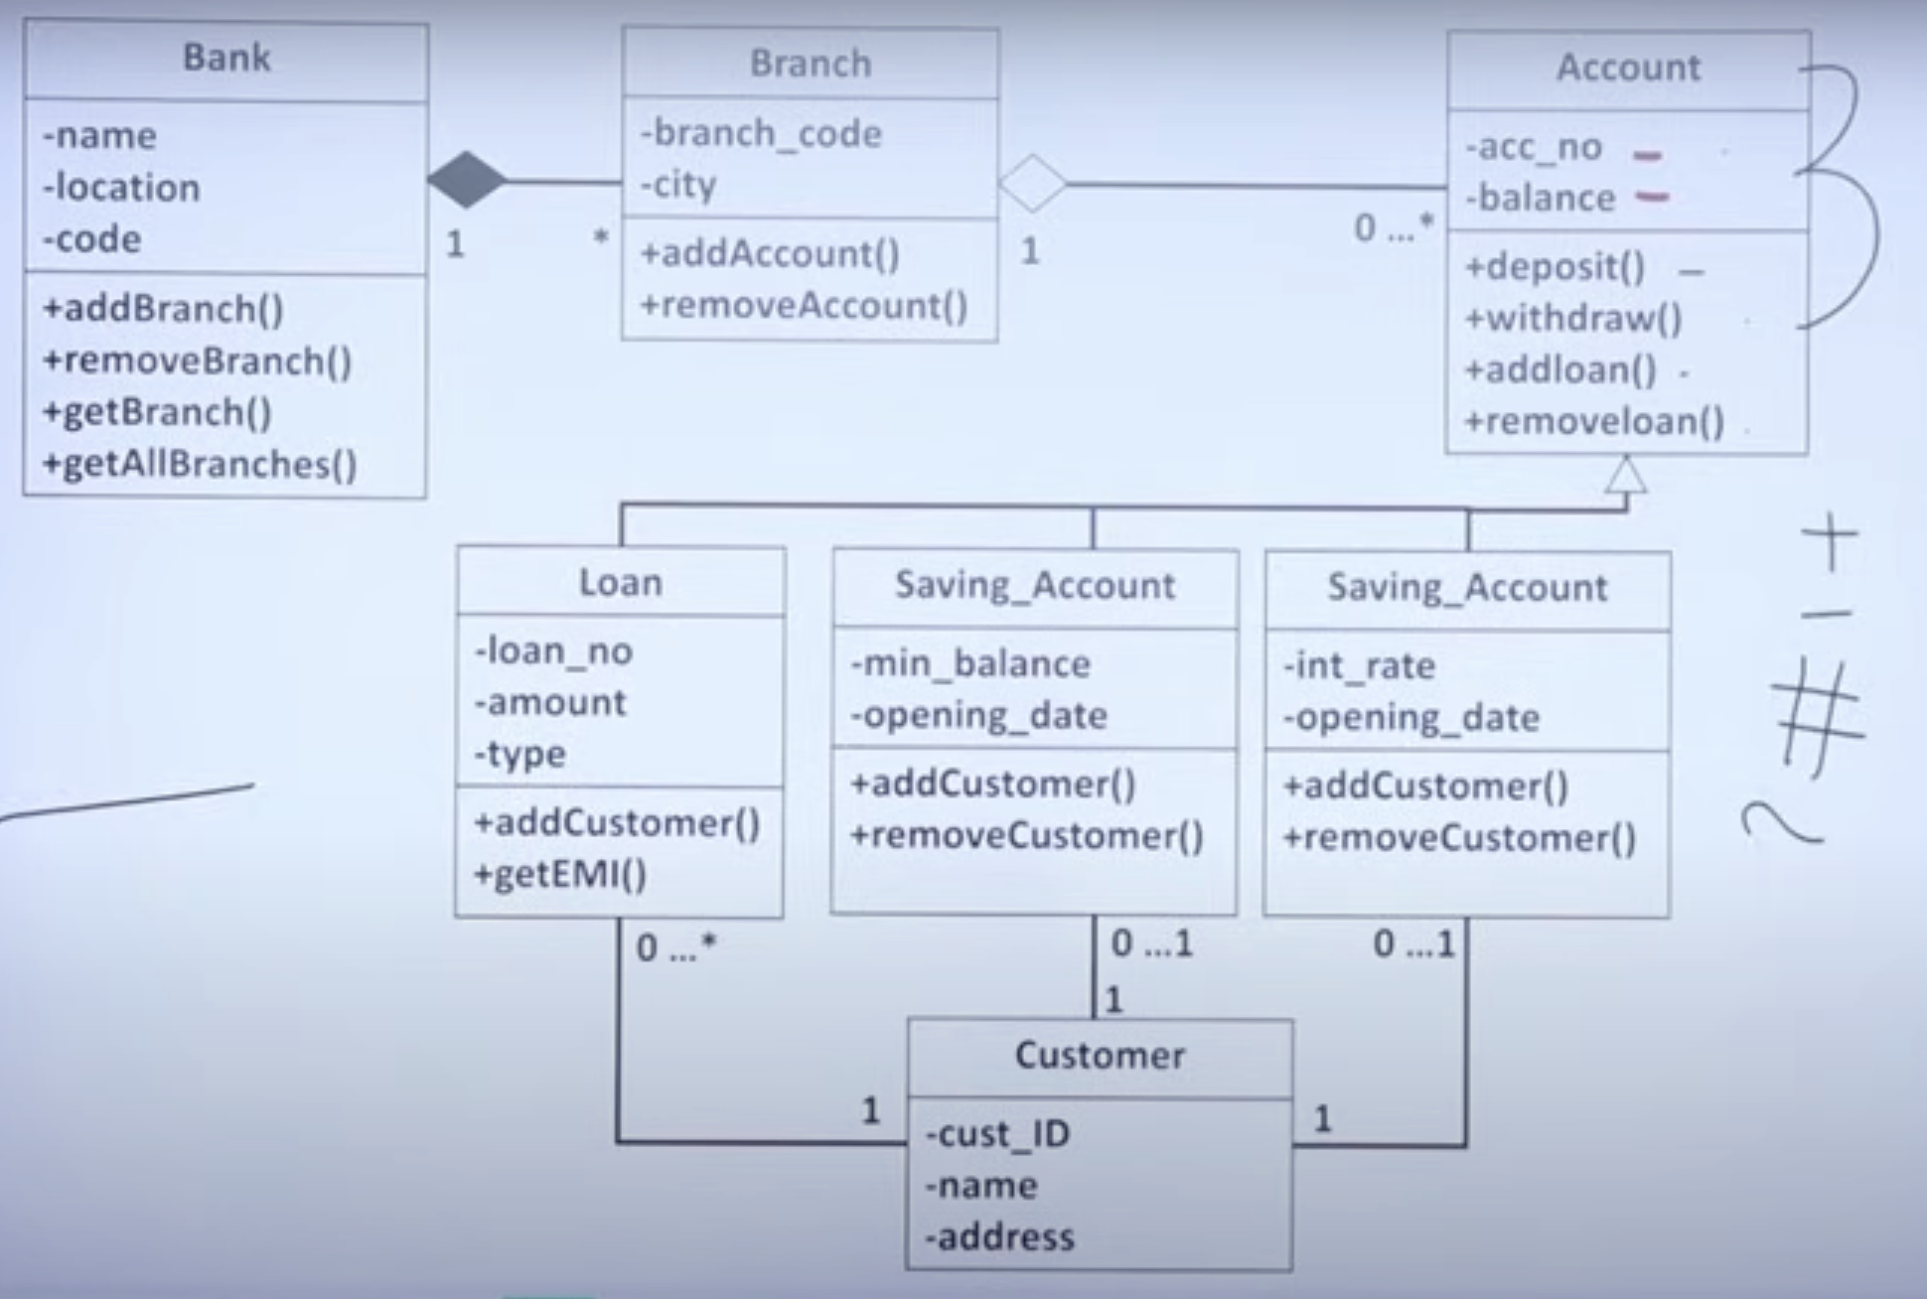
Example
Notes:
Link: https://www.youtube.com/watch?v=HuL9EMx8NQo

Slide 10
Design Class Types
Entity classes
Boundary classes
Controller classes
Data access classes
Notes:
Boundary class: an API class that receives requests and sends responses in a web service (user interface).
Controller: Manage the flow of control in the application, coordinating between boundary classes (user interface) and entity classes (business logic/data). In a game, a GameController class might manage the rules of play, taking user input from a boundary class and updating the game state (entity classes) accordingly.
Data access class: Handle the communication between the application and its data storage (e.g., databases). They provide methods for CRUD operations (Create, Read, Update, Delete).

Slide 11
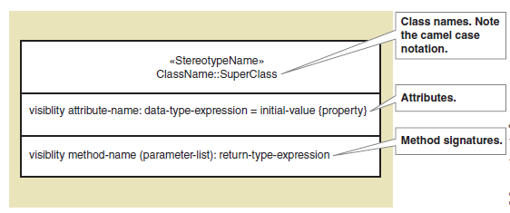
Design Class
Typical information included:
  Classes, associations, and attributes
  Interfaces, with their operations and constants
  Methods
  Attribute type information
  Navigability
  Dependencies

Slide 12
Design Class -- Attributes
Each attribute and operation are listed one per line in the appropriate compartment
Each attribute and operation name should start with a lower case letter*
Attribute and Operation names should have no spaces between multiple words in the name but should start each word with a capital letter e.g
  giveQuiz instead of givequiz or
  dateRegistered instead of dateregistered
Notes:
*The only exception to this is a constructor operations of a class, which will have the same name as the class itself in exactly the same uppercase and lowercase format

Slide 13
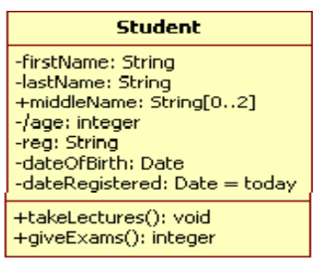
Design Class -- Attributes
Attributes and operations can be assigned a level of visibility on the class diagram with a visibility indicator.
The visibility of a feature can be defined by either a keyword or a symbol
  There are three specific types of visibility
  Private [represented with a symbol -]
  Public [represented with a symbol +]
  Protected [represented with a symbol #]
  There is no default value for visibility

Slide 14
Design Class -- Methods
The name, parameter list and return type of an operation are collectively known as its Signature
It is possible to have several operations with the same name and return type in one class provided that those operations each has a different parameter list to the other same name operations.
Knowing the operation signatures provides a clear specification for the collaboration between operations.

Slide 15
Design Class – Methods – Design Issues
Interpretation of the create() message.
  The create message is the UML language independent form to indicate instantiation and initialization.
    Equivalent to calling the constructor method of a class
Depiction of accessing methods.
  Accessing methods are those which retrieve attribute values (accessor method - get) or set attribute values (mutator method)
  It is common idiom to have an accessor and mutator for each attribute, and to declare all attributes private (to enforce encapsulation).

Slide 16
Adding Associations and Navigability
When instance of one class pass messages to instances of another class, an association is implied between those two classes
UML shows an association between the two classes as a solid line
The association can be labeled with a name to indicate the nature of the association
The direction or navigability is not recommended to model in class diagram, as it is purely an implementation issues.

Slide 17
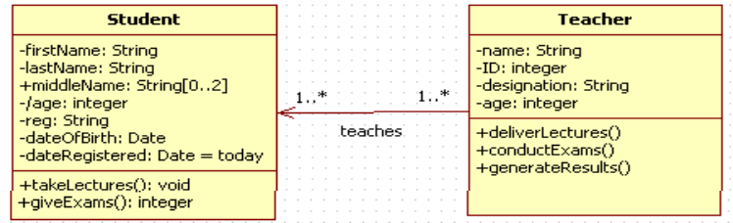
Adding Associations and Navigability
In terms of an association multiplicity indicates the number of object instances of the class at the far end of an association for one instance of the class at the near end of an association
  It is optional to add multiplicity in CD, why?

Slide 18
Association Types
General association
Is-A association (generalization)
Part-Of association
  Aggregation
  Composition

Slide 19
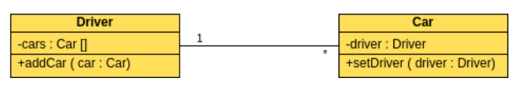
Association Types
General association
  A class only uses behaviors/functionalities (methods) of another class but does not change them by overriding them.
  A class does not inherit another class.
  A class does not include (own) another class as a public member.
  Both classes have independent lifetime where disposing of one does not automatically dispose of another.

Slide 20
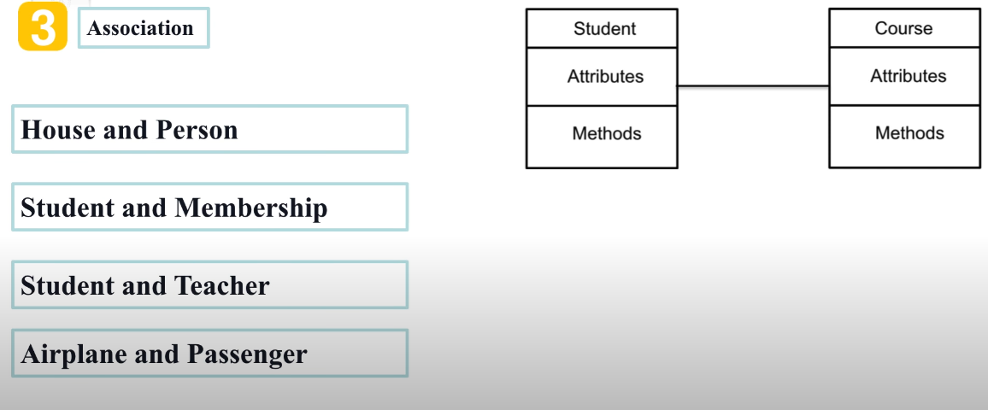
Association Examples

Slide 21
Association Types
Is-A Association (Generalization)
  Sometimes, some entities have few commonalities and differences among them, and these entities can be generalized based on the commonalities.
  In object-oriented languages, such as Java, generalization is implemented using the class inheritance mechanisms built into the language.
  In a generalization, the attributes and operations associated with higher-level classes are also associated with the lower-level classes.
  The lower-level classes are subclasses inherit the attributes and operations from their superclasses. These lower-level classes then add more specific attributes and operations.

Slide 22
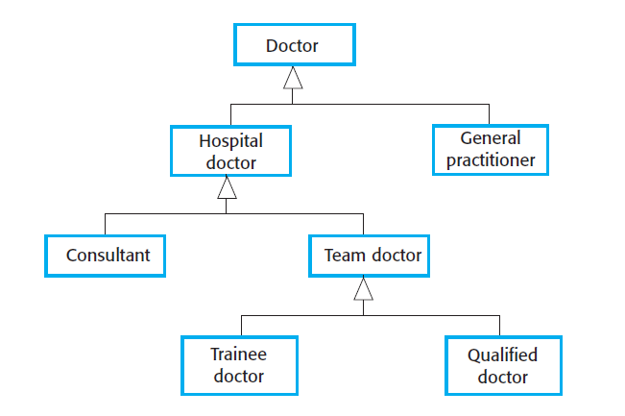
Association Types
Is-A Association (Generalization)

Slide 23
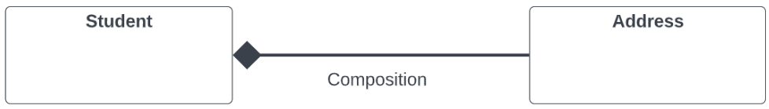
Association Types
Part-A Association (Composition (has-A)
  A class (parent) contains a reference to another class (child).
  The child class doesn't exist without the parent class.
  Deleting the parent class will also delete the child class.

Slide 24
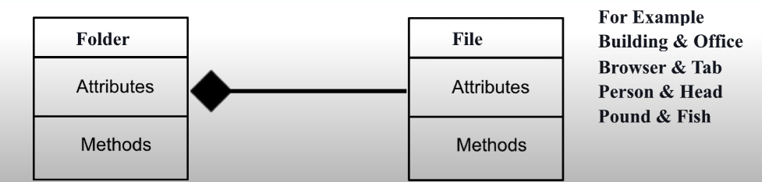
Composition Example

Slide 25
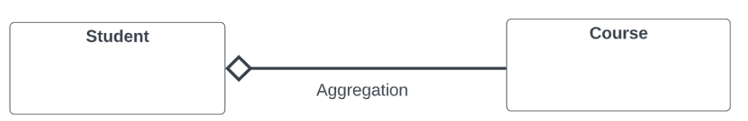
Association Types
Part-A Association (Aggregation)
  Aggregation is another type of composition ("has a" relation).
  A class (parent) contains a reference to another class (child) where both classes can exist independently.

Slide 26
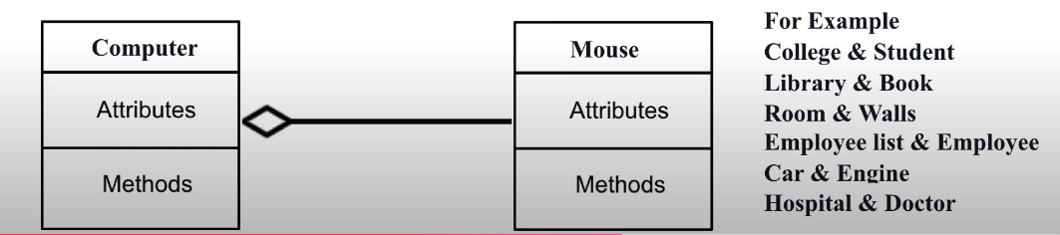
Aggregation examples

Slide 27
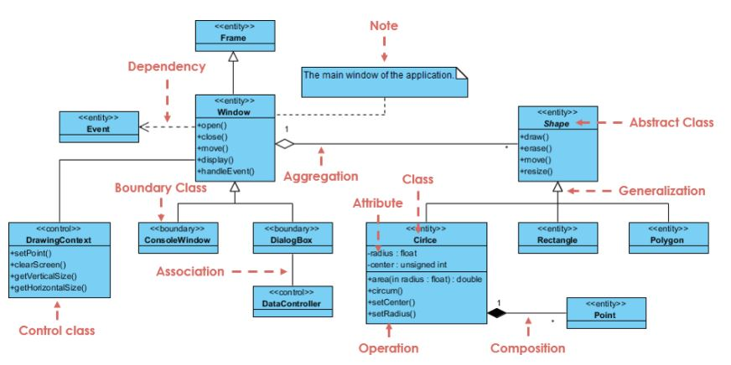
Design Class

Slide 28
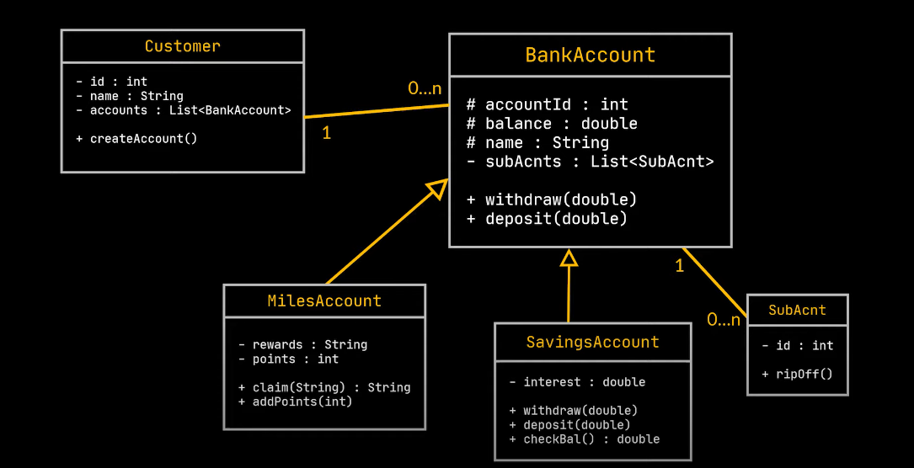

Slide 29
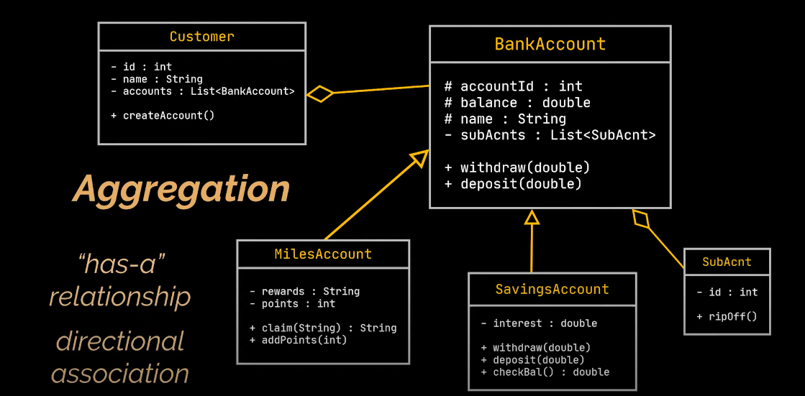

Slide 30
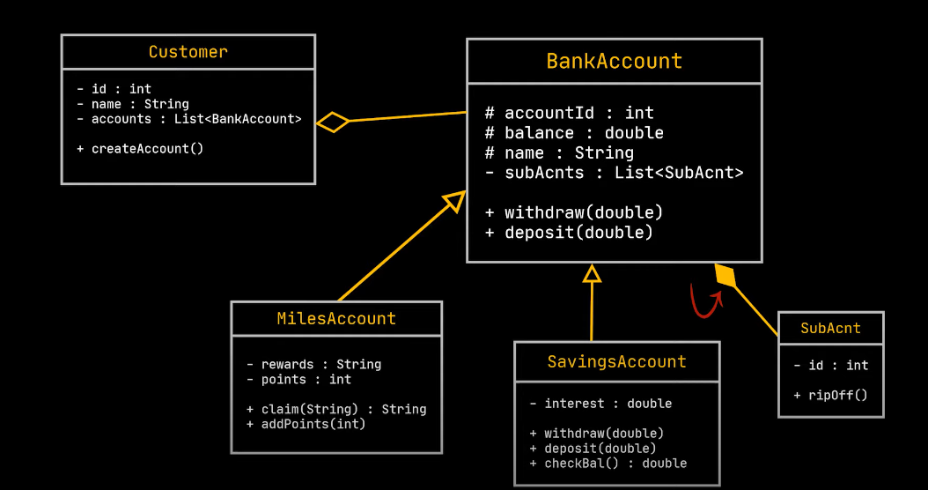

Slide 31
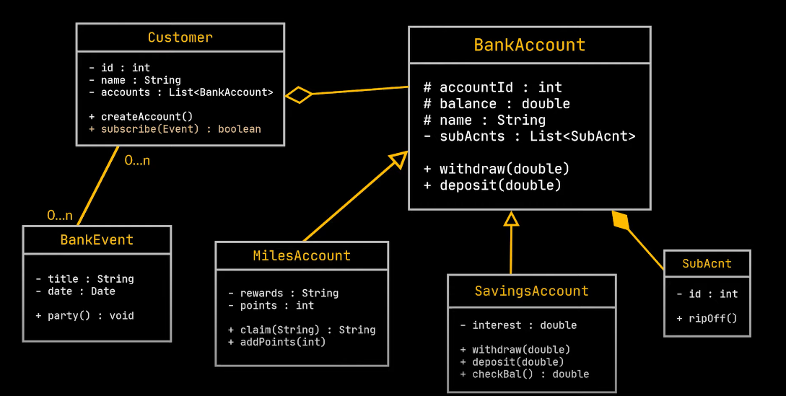

Slide 32
Interfaces
Interfaces allow you to specify what methods a class should implement.
Interfaces cannot have properties, while abstract classes can
All interface methods must be public, while abstract class methods is public or protected.
Classes can implement an interface while inheriting from another class at the same time.

Slide 33
Interfaces
Improves Maintainability, information hiding
Reduce coupling
Most designers use a dependency arrow and the «interface» stereotype
«interface»
Timer
getTime()
Clock1
getTime( )

Slide 34
Student Information Management System
Design a simple Student Information Management System (SIMS) for a university. The system will manage the information of students, the courses they are enrolled in, and the faculty responsible for teaching the courses. The system will store details about each student, the courses they take, and the instructors associated with those courses.
Student Information:
  Each student has a unique student ID, first name, last name, date of birth, and contact information. A student can enroll in multiple courses. Each student can only be enrolled in a specific course once per semester.
Course Information:
  A course has a unique course code, course title, and description. A course can have multiple students enrolled in it. A course is offered for a specific semester.
Instructor Information:
  Each course is taught by one instructor. An instructor has an instructor ID, name, department, and contact information. An instructor can teach multiple courses but not more than five in a single semester.
Enrollment Details:
  The system must track which students are enrolled in which courses. Each enrollment record must include the semester (e.g., Fall 2024) and the grade the student achieved in the course. A student cannot be enrolled in more than five courses per semester.
Additional considerations: Instructors may update the grades of the students at the end of each semester. The system should allow querying the list of courses an instructor is teaching in a given semester. The system should also allow querying the list of courses a student is enrolled in during a particular semester.

